Slide 1
Two-Way ANOVA
Cohen – chapter 13 textbook example

Slide 2
3 x 4 two-way ANOVA, complex motor tasks
DV (dependent variable)
score on a video game that simulates driving a large truck at night
IV (categorical independent variables)
Sleep deprivation (subjects spend four days in a sleep lab)
(1) Control: allowed to follow their own sleep schedule
(2) Jet Lag: keep usual amount, but not allow any during 11pm-7am
(3) Interrupted: usual amount, but no more that 2 hours at a time, separated by 1+ hours awake
(4) Total Deprivation: total lack of any sleep
Stimulant
(1) placebo: sugar pill, but told it is caffeine
(2) caffeine: caffeine pill, told it is caffeine
(3) reward: mild electric shocks for mistakes & money for good performance
Subjects
5 per sleep x stimulant combination… 5 x (4 x 3) = 5 x 12 = 60

Slide 3
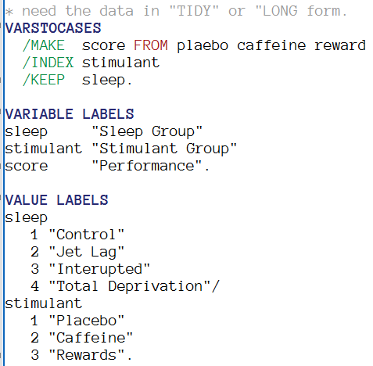
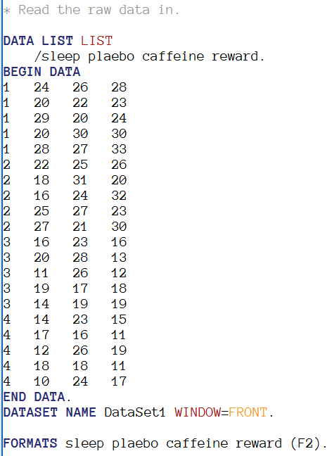
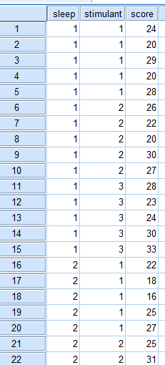
data
 | Placebo | Caffeine | Reward
Control | 24 | 26 | 28
 | 20 | 22 | 23
 | 29 | 20 | 24
 | 20 | 30 | 30
 | 28 | 27 | 33
Jet Lag | 22 | 25 | 26
 | 18 | 31 | 20
 | 16 | 24 | 32
 | 25 | 27 | 23
 | 27 | 21 | 30
Interrupted | 16 | 23 | 16
 | 20 | 28 | 13
 | 11 | 26 | 12
 | 19 | 17 | 18
 | 14 | 19 | 19
Total Lack | 14 | 23 | 15
 | 17 | 16 | 11
 | 12 | 26 | 19
 | 18 | 18 | 11
 | 10 | 24 | 17

Slide 4
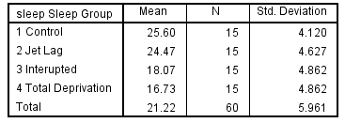
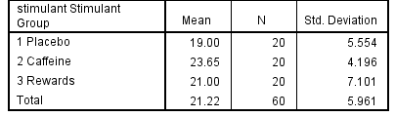

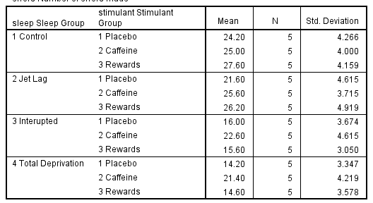
Marginal Mean’s
 | Placebo | Caffeine | Reward
Control | 24 | 26 | 28 | M = 25.6 N = 15
 | 20 | 22 | 23
 | 29 | 20 | 24
 | 20 | 30 | 30
 | 28 | 27 | 33
Jet Lag | 22 | 25 | 26 | M = 24.47 N = 15
 | 18 | 31 | 20
 | 16 | 24 | 32
 | 25 | 27 | 23
 | 27 | 21 | 30
Interrupted | 16 | 23 | 16 | M = 18.07 N = 15
 | 20 | 28 | 13
 | 11 | 26 | 12
 | 19 | 17 | 18
 | 14 | 19 | 19
Total Lack | 14 | 23 | 15 | M = 16.73 N = 15
 | 17 | 16 | 11
 | 12 | 26 | 19
 | 18 | 18 | 11
 | 10 | 24 | 17
 | M = 19.0 N = 20 | M = 23.65 N = 20 | M = 21.0 N = 20 | M = 21.217 N = 60
 | Placebo | Caffeine | Reward
Control | 24 | 26 | 28
 | 20 | 22 | 23
 | 29 | 20 | 24
 | 20 | 30 | 30
 | 28 | 27 | 33
Jet Lag | 22 | 25 | 26
 | 18 | 31 | 20
 | 16 | 24 | 32
 | 25 | 27 | 23
 | 27 | 21 | 30
Interrupted | 16 | 23 | 16
 | 20 | 28 | 13
 | 11 | 26 | 12
 | 19 | 17 | 18
 | 14 | 19 | 19
Total Lack | 14 | 23 | 15
 | 17 | 16 | 11
 | 12 | 26 | 19
 | 18 | 18 | 11
 | 10 | 24 | 17
 | Placebo | Caffeine | Reward
Control | 24.2 | 25.0 | 27.6 | 25.6
Jet Lag | 21.6 | 25.6 | 26.2 | 24.47
Interrupted | 16.0 | 22.6 | 15.6 | 18.07
Total Lack | 14.2 | 21.4 | 14.6 | 16.73
 | 19.0 | 23.65 | 21.0 | 21.217

Slide 5
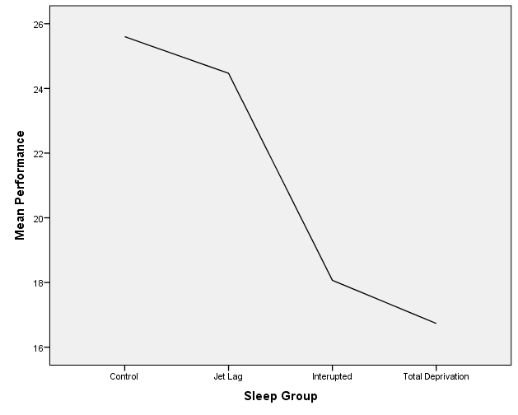
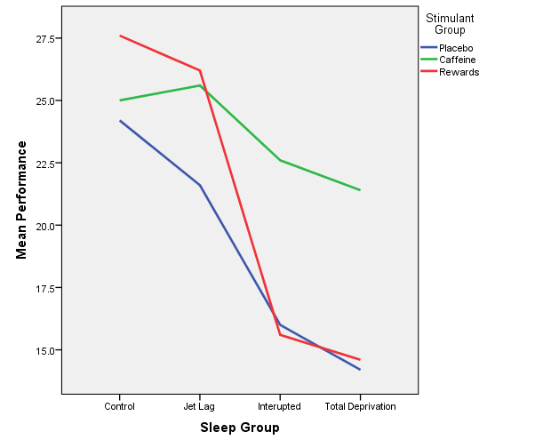
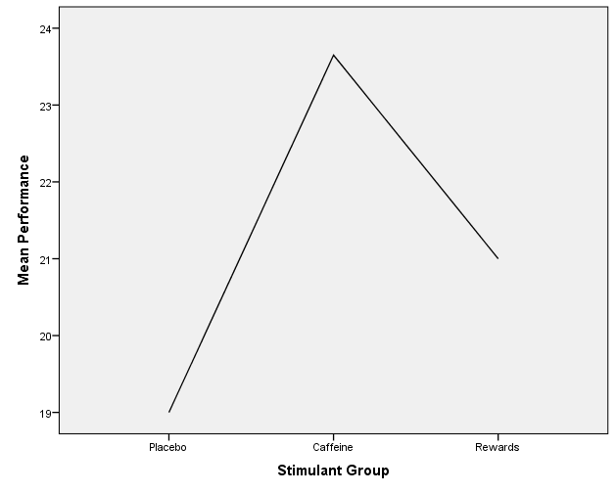
Plot of mean’s
 | Placebo | Caffeine | Reward
Norm | 24.2 | 25.0 | 27.6 | 25.6
Lag | 21.6 | 25.6 | 26.2 | 24.47
Int | 16.0 | 22.6 | 15.6 | 18.07
None | 14.2 | 21.4 | 14.6 | 16.73
 | 19.0 | 23.65 | 21.0 | 21.217
Main Effect of Sleep
Interaction between Sleep & Stimulant
Main Effect of Stimulant

Slide 6
Degrees of Freedom
c = number of columns
r = number of rows
n = subjects per cell
Total
60 – 1 = 59
Denominator of F ratios
Total
Between cells
Rows
Columns
Interaction
Within cells
= rnc – 1
= rc - 1
= r - 1
= c - 1
= (r – 1)(c – 1)
= rnc - rc
Between Cells
Within Cells
12 – 1 = 11
60 - 12 = 48
Rows
Columns
4 – 1 = 3
3 – 1 = 2
Interaction
Numerators of F ratios
3 x 2 = 6

Slide 7
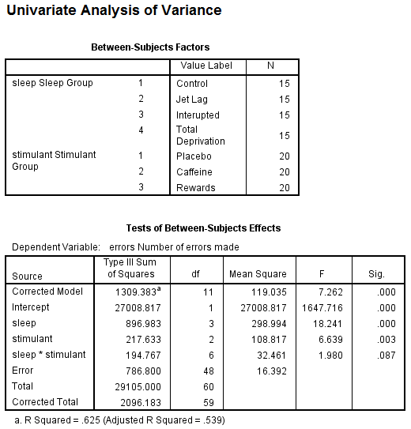
2-way ANOVA
 | SS | Df | MS | F | p
Between-Cells | 1309.38 | 11
SLEEP Row Groups | 896.98 | 3 | 298.99 | 18.241 | <.001
STIM Column Groups | 217.63 | 2 | 108.82 | 6.639 | .003
INTER (Row x Col) | 197.77 | 6 | 32.46 | 1.980 | .087
Within-Cells (Residual) | 786.80 | 48 | 16.39
Total | 2096.18 | 59
IF the interaction is significant…
main effects should not be interpreted in isolation

Slide 8



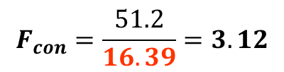




Interaction contrasts
$$2x2: {df}_{con}=\left(r−1\right)\left(c−1\right)=1$$
If the interaction is significant…
pick TWO PAIRS to compare (extreme)
Does CAFFEINE have the same effect in NO SLEEP as NORMAL SLEEP?
$c_{i}=$ 1, -1, -1, 1
Caffeine’s Effect in Normal
Caffeine’s Effect in None
$$\sum{c_{i}^{2}}=4$$
$$L= \left( {\overline{X}}_{11} − {\overline{X}}_{12} \right) − \left( {\overline{X}}_{21} − {\overline{X}}_{22} \right)$$
$$L={ \overline{ X}}_{11} − {\overline{X}}_{12} − {\overline{X}}_{21} + {\overline{X}}_{22}$$
 | Placebo | Caffeine | Reward
Norm | 24.2 | 25.0 | 27.6 | 25.6
Lag | 21.6 | 25.6 | 26.2 | 24.47
Int | 16.0 | 22.6 | 15.6 | 18.07
None | 14.2 | 21.4 | 14.6 | 16.73
 | 19.0 | 23.65 | 21.0 | 21.217
 | Placebo | Caffeine
Norm | 24.2 | 25.0
 | Placebo | Caffeine | Reward
Norm | 24.2 | 25.0 | 27.6 | 25.6
Lag | 21.6 | 25.6 | 26.2 | 24.47
Int | 16.0 | 22.6 | 15.6 | 18.07
None | 14.2 | 21.4 | 14.6 | 16.73
 | 19.0 | 23.65 | 21.0 | 21.217
$$L={ 1∙\overline{ X}}_{11} + −1∙{\overline{X}}_{12} + −1∙{\overline{X}}_{21} +1∙{\overline{X}}_{22}$$
$$L={ 1∙}_{} + −1∙ + −1∙ +1∙$$
$$L=24.2 −25.0 −14.2+21.4=6.4$$
24.2
25.0
$${SS}_{con}= \frac{n∙L^{2}}{\sum{c_{i}^{2}}}$$
$$F_{con}= \frac{{SS}_{con}}{{MS}_{W}}$$
14.2
21.4
None | 14.2 | 21.4
$${SS}_{con}=\frac{5∙{6.4}^{2}}{1+1+1+1}=\frac{5∙40.96}{4}=\frac{204.8}{4}=51.2$$
$$F_{Scheffe}={df}_{int}∙F\left({df}_{int}, {df}_{W}\right)$$
$$F_{con}=\frac{51.2}{16.39}=3.12$$
$F_{Scheffe}=6∙F\left(6, 48\right)=6∙F_{.05}\left(6, 40\right)=6∙2.34=14.04$

Slide 9

Interaction contrasts
Does CAFFEINE have the same effect in NO SLEEP as NORMAL SLEEP?
 | Placebo | Caffeine | Reward
Norm | 24.2 | 25.0 | 27.6 | 25.6
Lag | 21.6 | 25.6 | 26.2 | 24.47
Int | 16.0 | 22.6 | 15.6 | 18.07
None | 14.2 | 21.4 | 14.6 | 16.73
 | 19.0 | 23.65 | 21.0 | 21.217
$$F_{contrast}=3.12$$
Vs
$F_{Scheffe}=14.04$
0.8
7.2
Are the lines PARALLEL?
Just compare the 2 pairs of points
(ignore the rest)
This provides no evidence
that CAFFEINE has a different effect
in NORMAL SLEEP vs TOTAL DEPRIVATION.

